Slide 1
Mobile Plan Search & Recommendation System
Saima Khatoon
khatoons@uwindsor.ca
Chandravallika Murarisetty
murarisc@uwindosr.ca
Aoqing Liu
liu582@uwindsor.ca
Tausif Zaman
zaman45@uwindsor.ca
Weiming Zheng
zheng2c@uwindsor.ca
Group No. 12
Group name: All for one
School of Computer Science
University of Windsor
Presented Dec. 3, 2024

Slide 2
Variant of Choice: Mobile Data Plan Analysis
The idea of the project is to analyze and understand various mobile data plans available locally (Canada, U.S., etc.) and/or worldwide.

Slide 3
Mobile Plan Search and Recommendation System
The Mobile Plan Search and Recommendation System is an advanced, feature-rich application designed to assist users in selecting the most suitable mobile data plans by evaluating various criteria such as data usage, cost, and plan features. This system aims to streamline the decision-making process for users by offering intelligent recommendations and advanced search capabilities.
Websites selected for crawling by team members:
Aoqing Liu – Fido
Chandravallika Murarisetty - Freedom
Saima Khatoon - Verizon
Tausif Zaman – Public Mobile
Weiming Zheng - Rogers

Slide 4
Variant of Choice: Mobile Data Plan Analysis
Specify the details of your search:
Plan details (monthly fees, contract length, speed, internatinal call/text,etc)
Data allowance (unlimited or specific data caps)
Additional features (e.g., international roaming, hotspot data, 5G support)
Family plans and discounts

Slide 5
Variant of Choice: Mobile Data Plan Analysis
Implement required features (see Final Project Information.pdf) and ensure that your project has the following elements:
Data extraction: Crawl each carrier’s website and collect plan details
Data comparison: Compare pricing, data limits, and additional features across carriers
Develop a recommendation system to show the best mobile data plan based on user preferences (e.g., high data users, frequent travelers, budget-conscious users).

Slide 6
Variant of Choice: Mobile Data Plan Analysis
Final Project Information.pdf
Web crawler
HTML parser
Spell checking
Word completion
Frequency count
Search frequency
Page ranking
Inverted indexing
Data validation using regular expressions
Finding patterns using regular expressions.

Slide 7
Contribution
main
└── java
└── com.mac.acc
├── datacomparison -- Chandravallika Murarisetty
│ ├── DataComparison -- Chandravallika Murarisetty
│ └── MobilePlans -- Chandravallika Murarisetty
├── features
│ ├── SearchBar – Tausif Zaman
│ ├── SearchFrequencyQuery – Weiming Zheng
│ ├── SearchFrequencyQueryFactory– Weiming Zheng
│ ├── SimpleSearchFrequencyQuery– Weiming Zheng
│ ├── SpellChecker – Tausif Zaman
│ └── WordCompletion – Aoqing Liu
├── recommendation – Aoqing Liu
│ ├── Package – Aoqing Liu
│ ├── PackageRecommender – Aoqing liu
│ ├── ScoredPackage – Aoqing Liu
│ └── UserPreferences – Aoqing Liu
search
├── engine– Weiming Zheng
│ ├── Document– Weiming Zheng
│ ├── Field– Weiming Zheng
│ └── SearchEngineFactory– Weiming Zheng
└── ui
├── Features - Saima Khatoon
├── HomeTab - Saima Khatoon
├── LogEntry– Weiming Zheng
├── MobilePlanRecommendationSystem - Saima Khatoon
├── PageRankingUI -- Chandravallika Murarisetty
├── RecommendationTab – Aoqing Liu
├── SearchBarUI - Saima Khatoon, Tausif Zaman
└── SupportTab – Saima Khatoon
resources
├── logback.xml– Weiming Zheng
├── mobile_plans.csv -- Aoqing Liu
└── URLs.txt -- Chandravallika Mruarisetty

Slide 8
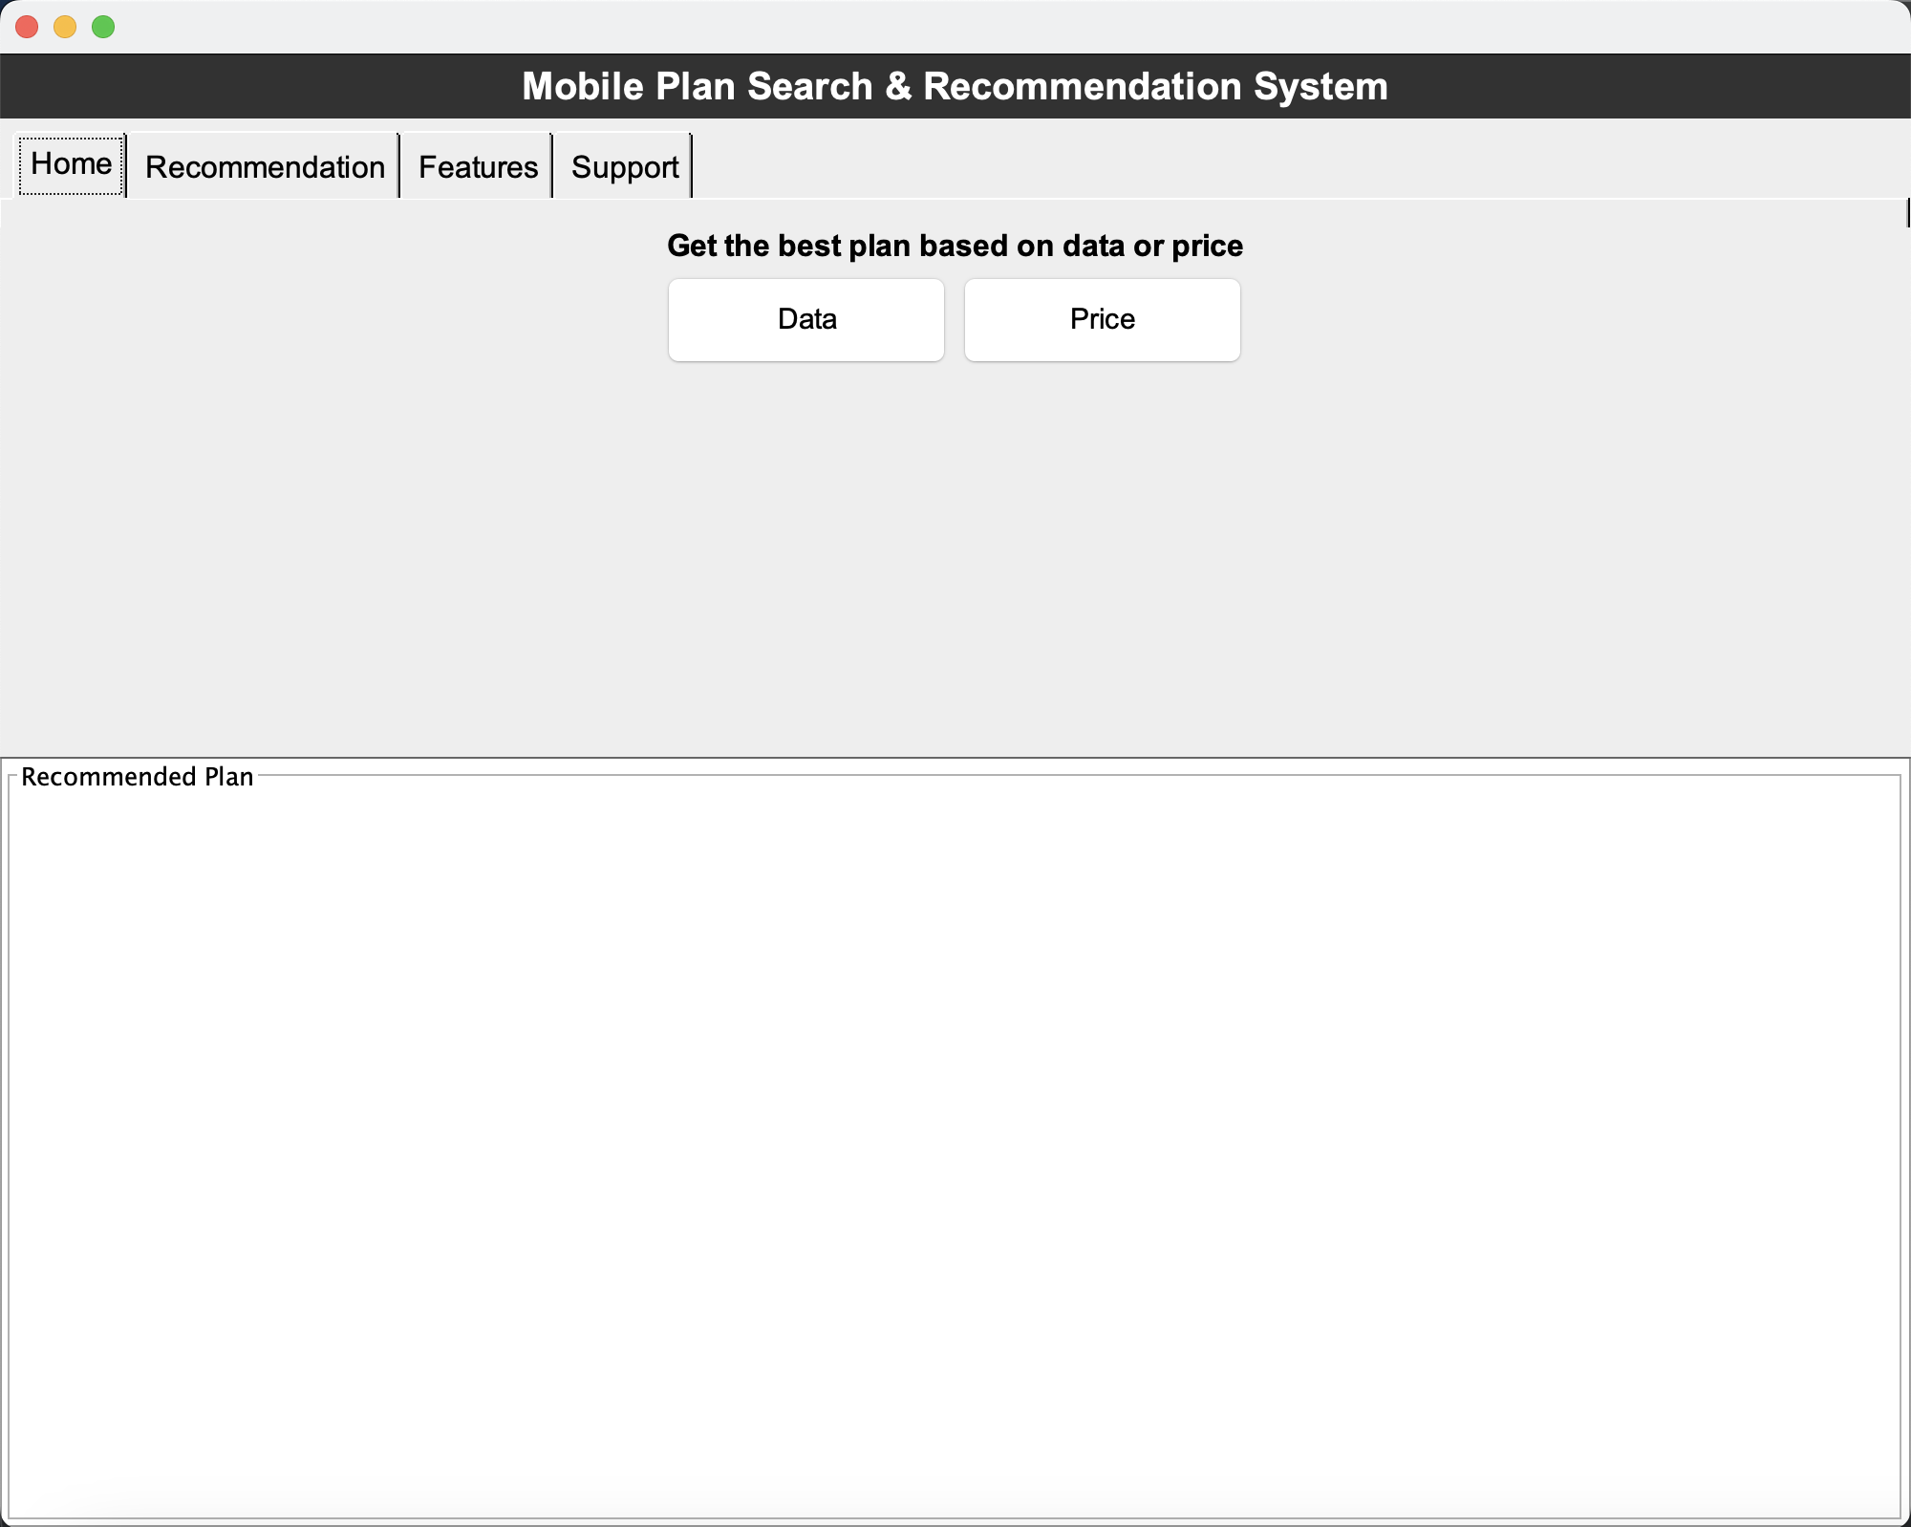
Additional Features - GUI
Used Java Swing for user interface
Suitable for desktop applications
Swing has Cross-Platform Compatibility
Swing offers a comprehensive set of GUI components - JPanel, JEditorPane, JTextField, JButton, and JLabel.
Swing is lightweight compared to older libraries like AWT
Swing's event-driven model enables handling user interactions efficiently through various listeners:
ActionListener
Button-based actions
HyperLink Listener

Slide 9
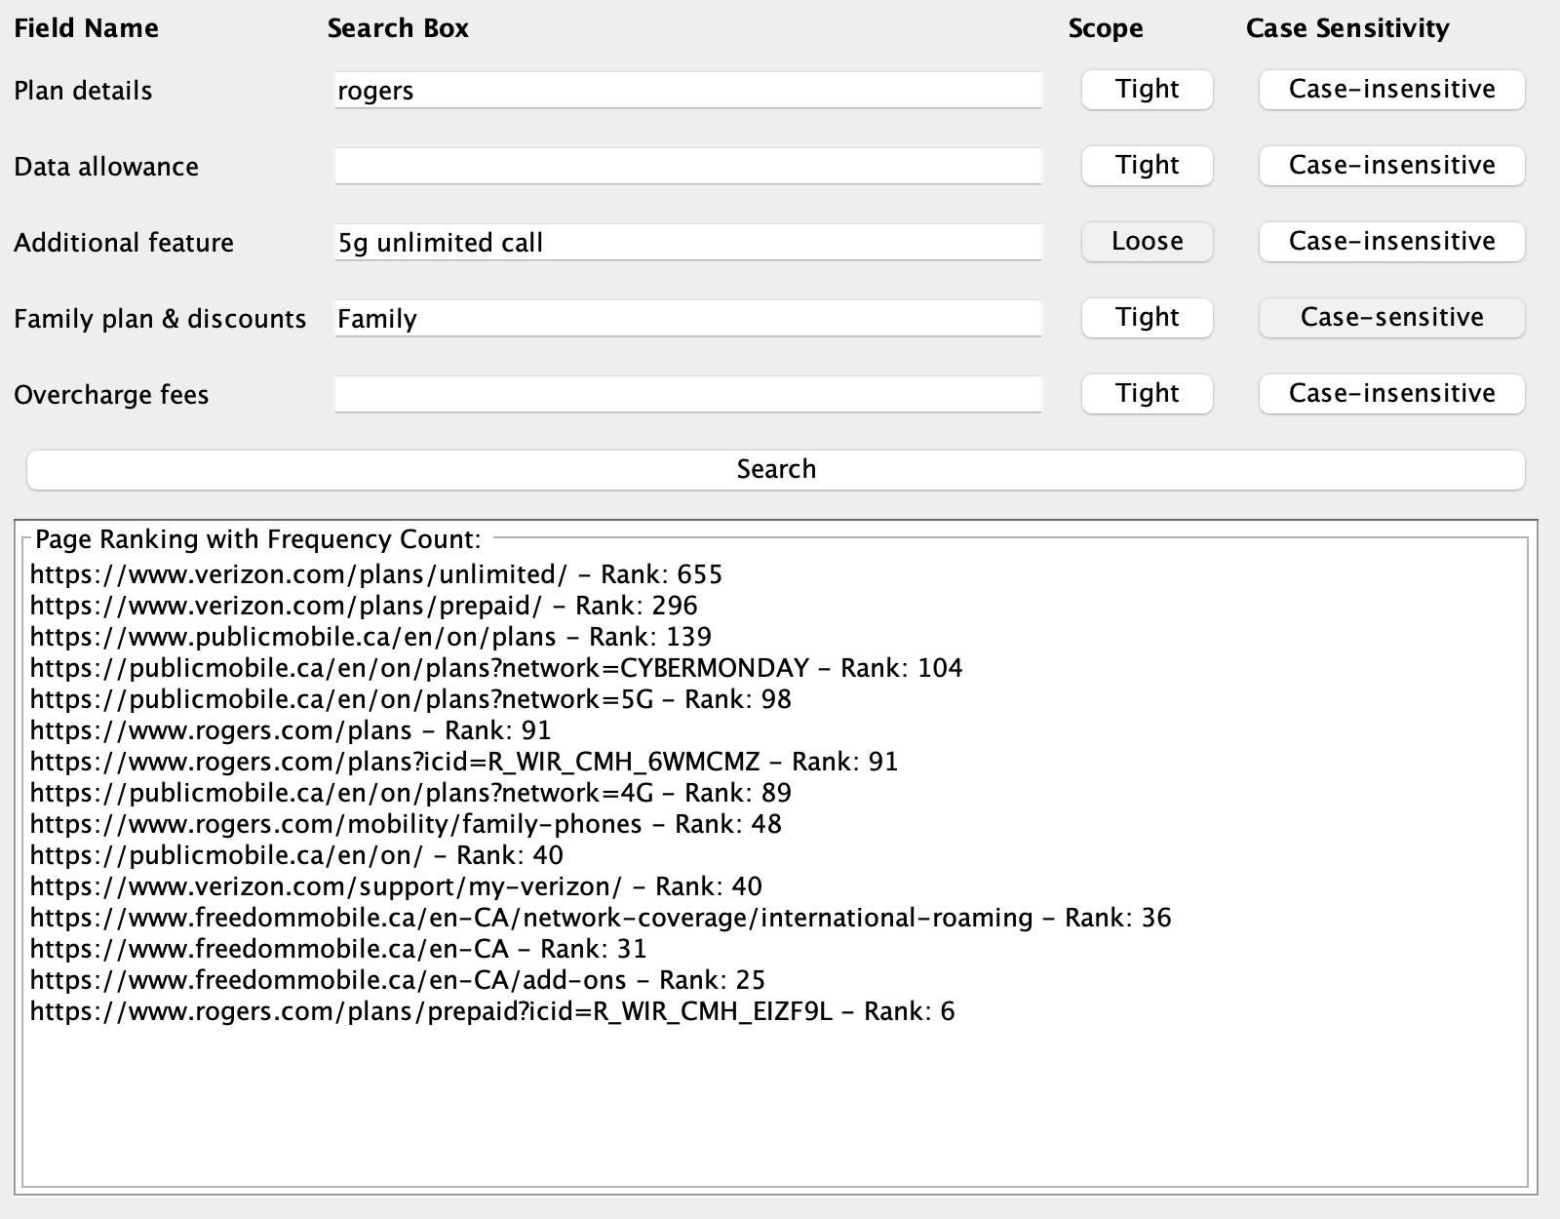
Additional Features – Advanced Search
Fine grained search field
Customized search condition

Slide 10
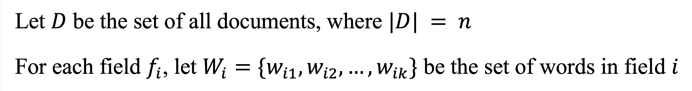
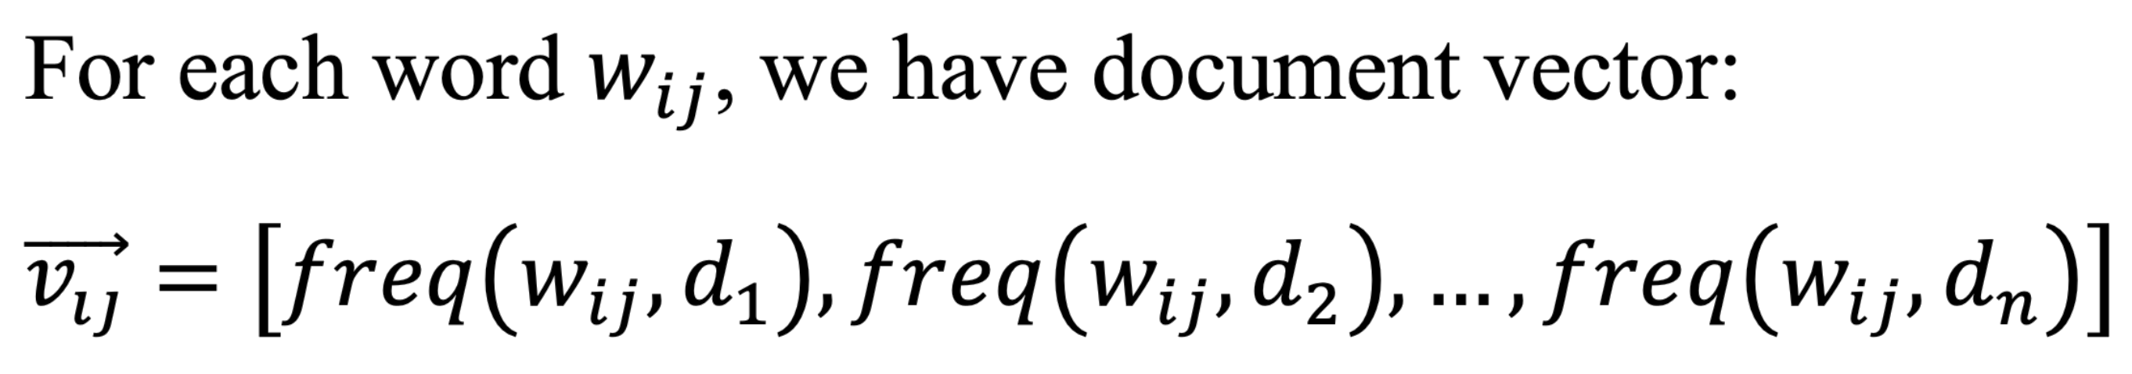
Additional Features – Advanced Search
Definitions
Word Level Vectors

Slide 11
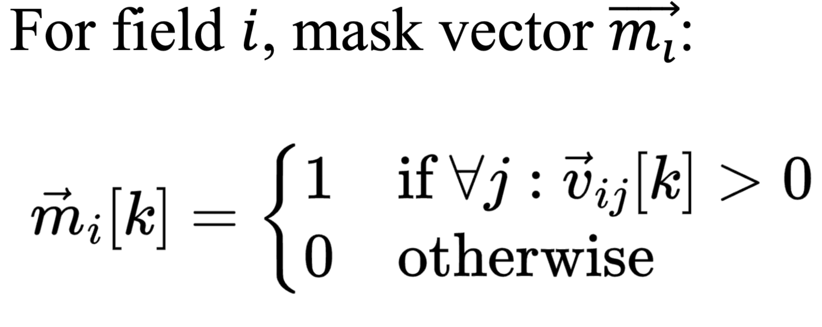
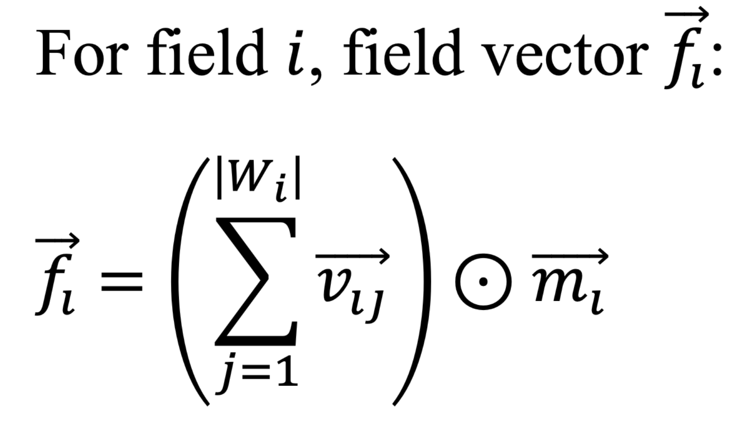
Additional Features – Advanced Search
Mask Vectors
Field Level Vectors

Slide 12
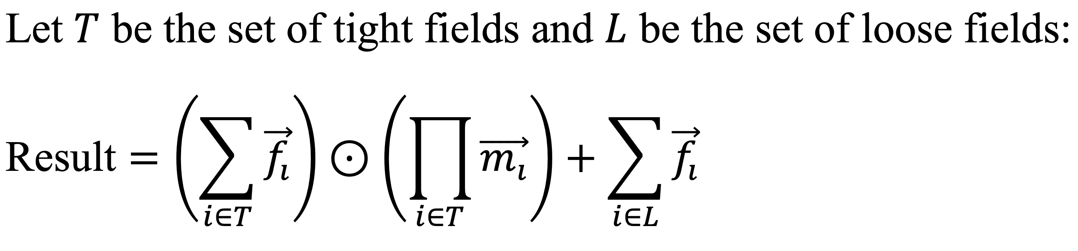
Additional Features – Advanced Search
Final Result

Slide 13
Task Response
Search Engine
HTML Parser
Inverted Index
Frequency Count
Page Ranking
Advanced Search
Fig x. Search Pages Demo Screenshot

Slide 14
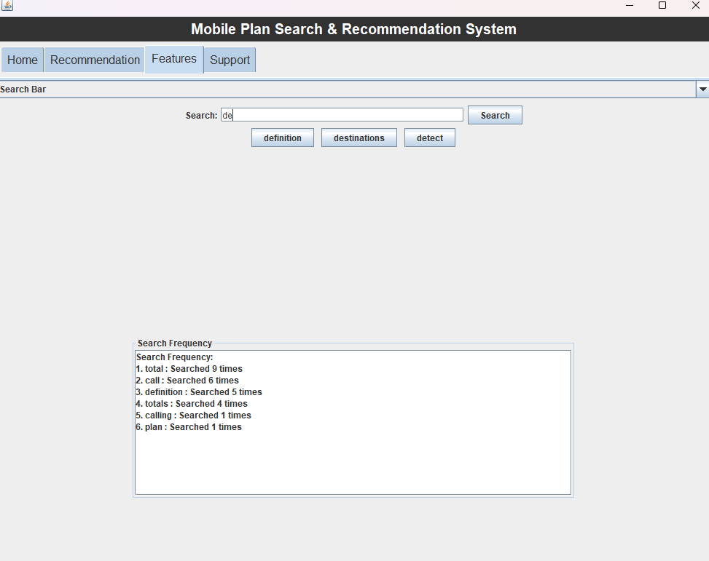
Task Response
Search Bar
Search Frequency
Shows frequency of words sorted by the number of times they were looked up
Word Completion
Identifies and suggests corrections for misspelled words.
Data structure: Trie
Spell Checker
Tracks and displays the most frequently searched queries
Data structure: Trie

Slide 15
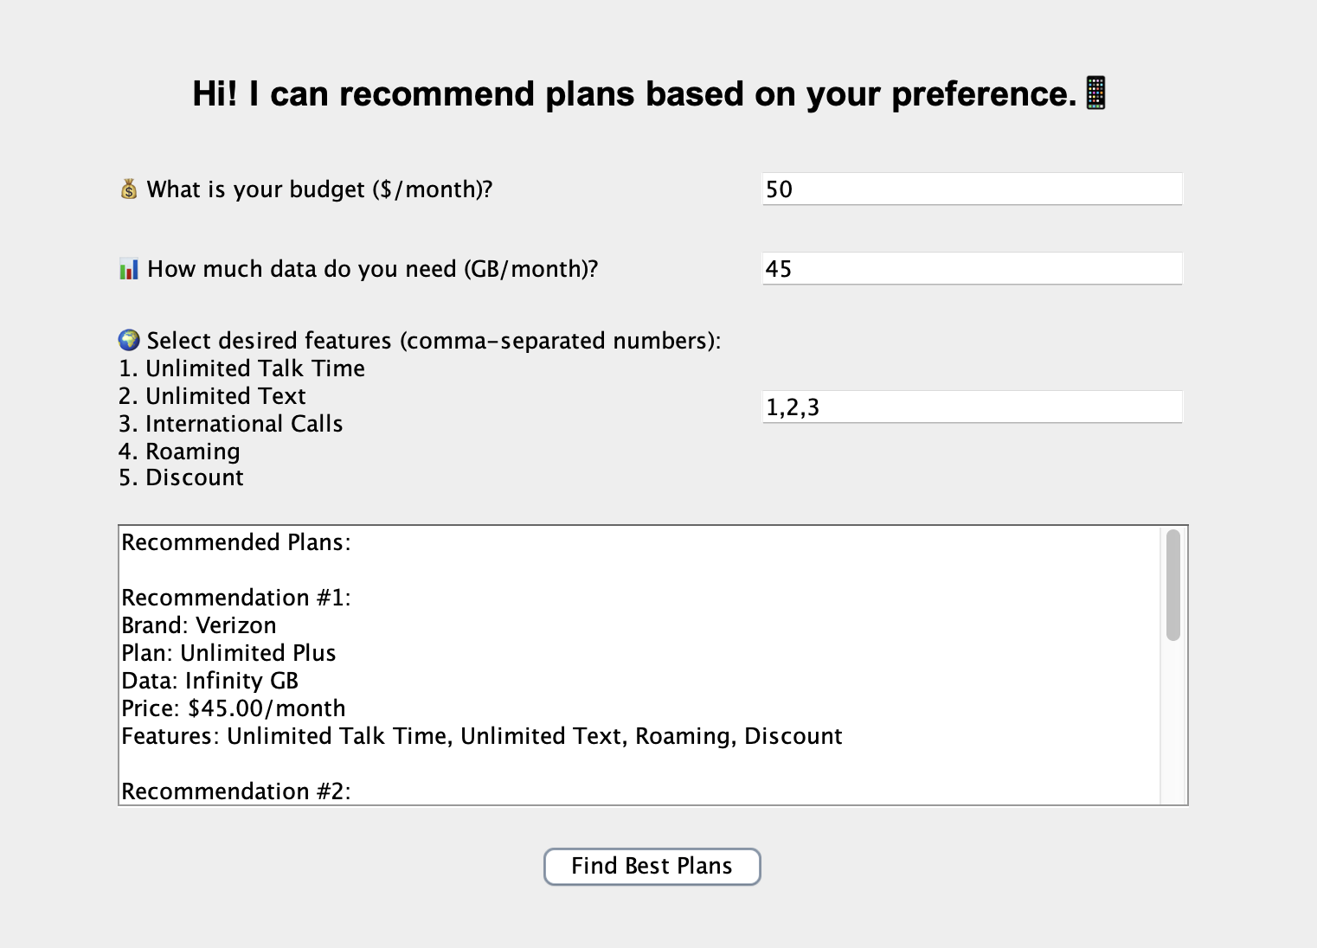
Task Response
Plan Recommendation
Input&Output: Recommendation based on 3 questions—1.Budget, 2.Data , 3.Features. Give 3 recommend plans.
Algorithms: Collecting these 3 type of information, calculate scores of each plan.(eg,If the package provides 150% more than the user's expectations within the budget, 5 points will be added, and 4 points will be added if it is within the range of 80%-150%. ) Maintain a priority queue to store the top 3 scored plans.
Data Extraction: Including reading data from csv file, matching with Regex ,etc.
Data structure :
Priority queue
Hash Map

Slide 16
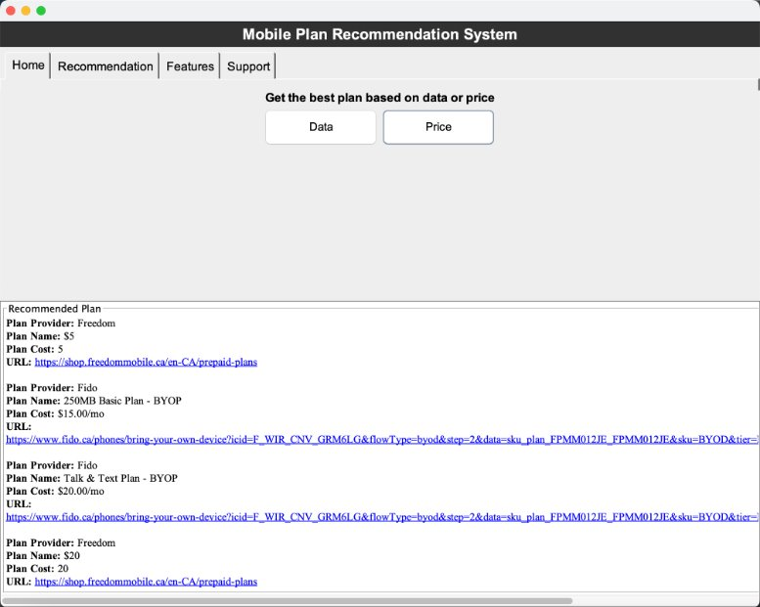
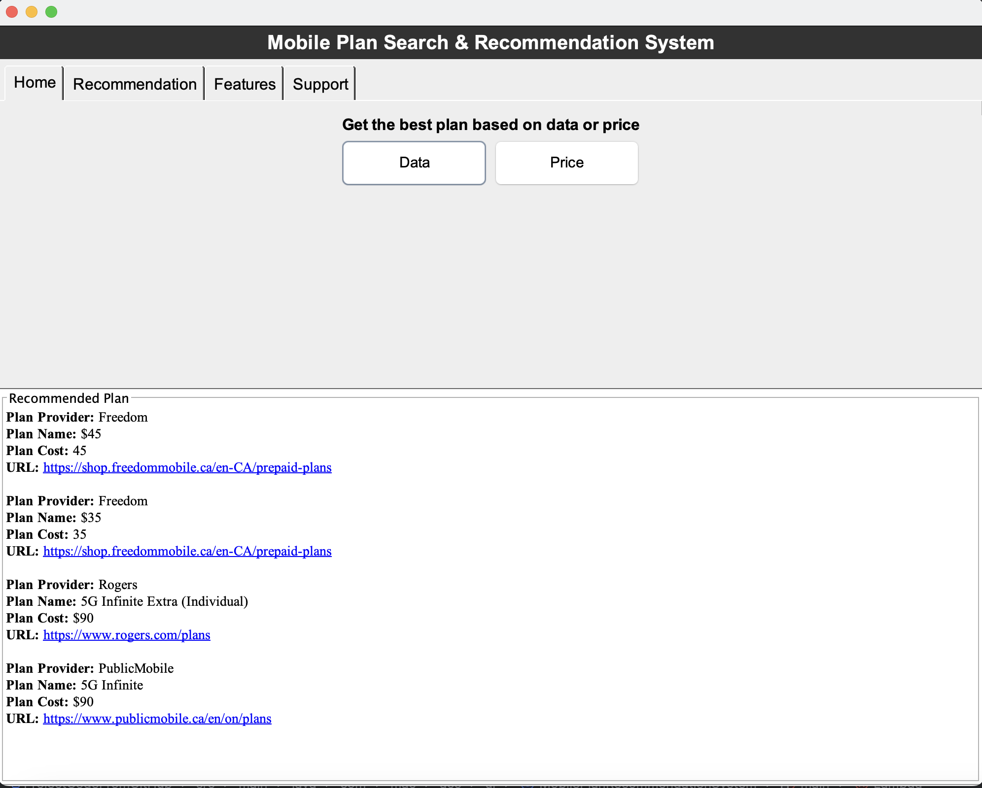
Task Response
Data Comparison
Comparisons made by plan cost and plan data
Comparison By plan cost
Reading the data from csv files and storing
Data Validation using regular expression
Sorting the plans by cost in descending order
Comparison By data
Data Validation using regular expression
Calculating the cost of 1GB for each plan
And sorting the plans based on the data
Data structures used
HashMap
Stream
List

Slide 17
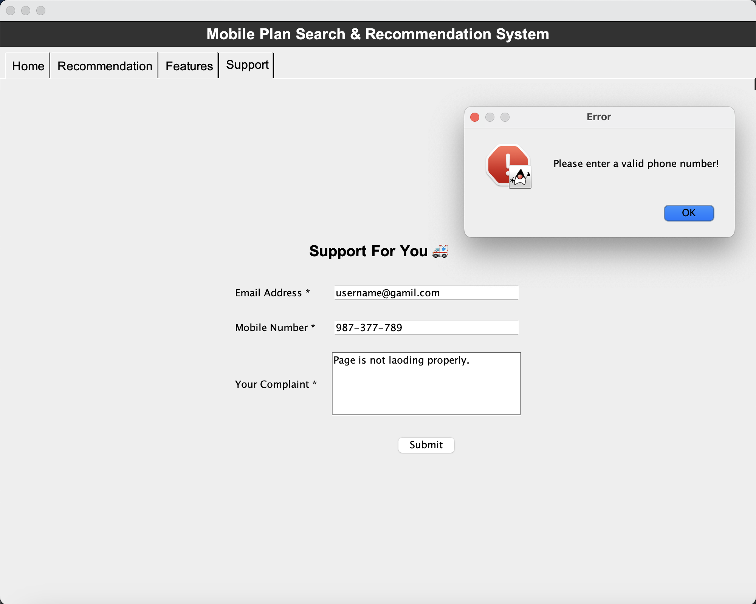
Task Response
Regular Expression Validation
Mainly used in Support Page
Validate user input for submitting complaints
Validate Email Address
Uses regex to validate the email format.
Validate Mobile number
Uses regex to validate phone numbers.
Empty Field Validation
Ensures all required fields are filled.
Stored complaint data in a file
Provide Error in alert form
Alert when at least one of the field is empty
Alert of unsuccessful validation
Label: "Email Address *" indicating it's a required field.

Slide 18
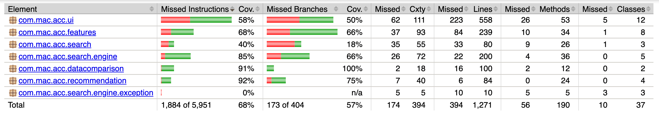
Test Coverage
Tools
JUnit [1]
JaCoCO [2]
Result

Slide 19
References
https://mvnrepository.com/artifact/org.junit.jupiter/junit-jupiter-api
https://mvnrepository.com/artifact/org.jacoco/jacoco-maven-plugin

Slide 20
Live Demo of the Project

Slide 21
Thank you for your listening!
Any comment and question are appreciated!

